Slide 1
Inductive Strength

Slide 2
Conditions for a strong inductive argument
Inductive arguments, like deductive arguments, can be well reasoned or poorly reasoned.
A well-reasoned inductive argument is called a strong inductive argument.
More precisely, in a strong inductive argument, the conclusion follows probably from the premises.
Put otherwise, a strong inductive argument is an argument in which the following conditions apply:
If the premises are true, the conclusion is probably true. The premises provide probable, but not logically conclusive, grounds for the truth of the conclusion. The premises, if true, make the conclusion likely.

Slide 3
Examples of strong inductive arguments
Here are two examples of strong inductive arguments:
Most college students own MP3 players. Andy is a college student. So, Andy probably owns an MP3 player.
All recent U.S. presidents have been college graduates. Thus, it is likely that the next U.S. president will be a college graduate.
An inductive argument that is not strong is said to be weak. In a weak inductive argument, the conclusion does not follow probably from the premises.
In other words, a weak argument is an inductive argument in which the premises, even if they are assumed to be true, do not make the conclusion probable.

Slide 4
Examples of inductively weak arguments
Here are two examples of inductively weak arguments:
All previous popes have been men. Therefore, probably the next pope will be a woman.
Fifty-five percent of students at East Laredo State University are Hispanic. Li Fang Wang, owner of Wang’s Chinese Restaurant, is a student at East Laredo State University. Therefore, Li Fang Wang is probably Hispanic.
Because the conclusions of these arguments are not probably true even if we assume that the premises are true, the arguments are weak.

Slide 5
A combination of truth and falsity
Like deductively valid arguments, inductively strong arguments can have various combinations of truth or falsity in the premises and conclusion.
Some strong arguments have false premises and a probably false conclusion. For example:
All previous U.S. vice presidents have been women. Therefore, it is likely that the next U.S. vice president will be a woman.
Some inductively strong arguments have false premises and a probably true conclusion. For example:
Every previous U.S. president has been clean-shaven. So, the next U.S. president probably will be clean-shaven.
And some inductively strong arguments have true premises and a probably true conclusion. For example:
No previous U.S. president has been a native Alaskan. So, the next U.S. president probably will not be a native Alaskan.

Slide 6
What strong inductive arguments cannot have
As with valid deductive arguments, however, there is one combination of truth or falsity no strong inductive argument can ever have.
Because, by definition, a strong inductive argument is an argument in which the conclusion follows probably from the premises, no strong inductive argument can have true premises and a probably false conclusion.
Weak inductive arguments, on the other hand, like invalid deductive arguments, can have any combination of truth or falsity in the premises and conclusion. Here are some examples:
Most U.S. presidents have been married. Therefore, probably the next U.S. president will be a man.
Most U.S. presidents have been over fifty years old. Therefore, probably the next U.S. president will be single.
Most U.S. presidents have been women. Therefore, probably the next U.S. president will be married.

Slide 7
What strong inductive arguments cannot have (cont.)
Each of these inductive arguments is weak.
That is, each has a conclusion that does not follow probably from the premise, even if we assume that the premise is true.
The first argument has a true premise and a probably true conclusion.
The second argument has a true premise and a probably false conclusion.
The third argument has a false premise and a probably true conclusion.

Slide 8
What to ask yourself
As these examples make clear, whether an inductive argument is strong or weak generally does not depend on the actual truth or falsity of the premises and the conclusion.
Rather, it depends on whether the conclusion would probably be true if the premises were true.
Thus, the key question we ask about inductive strength is this: If the argument’s premises were true, would the conclusion probably be true?
If the answer is yes, the argument is strong. If the answer is no, the argument is weak.

Slide 9
Strength which comes in degrees
The concept of inductive strength is similar in many ways to the concept of deductive validity, but there is one important difference:
Inductive strength, unlike deductive validity, does come in degrees.
Deductive arguments, as we have seen, are either 100 percent valid or 100 percent invalid.
Inductive arguments, in contrast, can be more or less strong or weak.

Slide 10
Strong yet still a bad argument
Finally, keep in mind that an inductive argument can be strong and yet still be a bad argument. For example:
All previous U.S. presidents have worn togas. Therefore, probably the next U.S. president will wear a toga.
Although this argument is inductively strong, it is a poor argument because the premise is obviously false.
A good inductive argument must both be strong (i.e., inductively well reasoned) and have all true premises.
If an argument both is inductively strong and has all true premises, it is said to be a cogent argument.
If an inductive argument either is weak or has at least one false premise, it is an uncogent argument.

Slide 11
Cogent and uncogent arguments
Consider these examples:
No U.S. president has been a U.S. skateboarding champ. Therefore, probably the next U.S. president will not be a U.S. skateboarding champ.
All previous U.S. presidents have been Democrats. Therefore, probably the next U.S. president will be a Democrat.
All previous U.S. presidents have been professional football players. Therefore, probably the next U.S. president will be an astronaut.
The first argument is cogent because it meets both conditions of a cogent argument: Its premise is true and the argument is strong.
The second argument is uncogent because it fails one of the conditions of a cogent argument: Its premise is false.
The third argument is uncogent because it fails both conditions of a cogent argument: Its premise is false and the argument is weak.

Slide 12
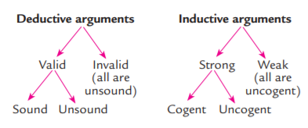
Diagrams of definitions
In light of the preceding definitions, arguments may be diagrammed as follows:

Slide 13
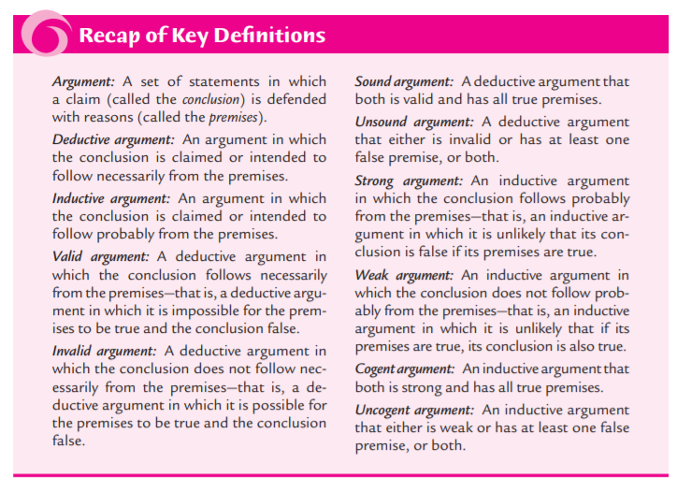

Slide 14
Lecture exercise
Exercise 3.5, page 81.

